Slide 2
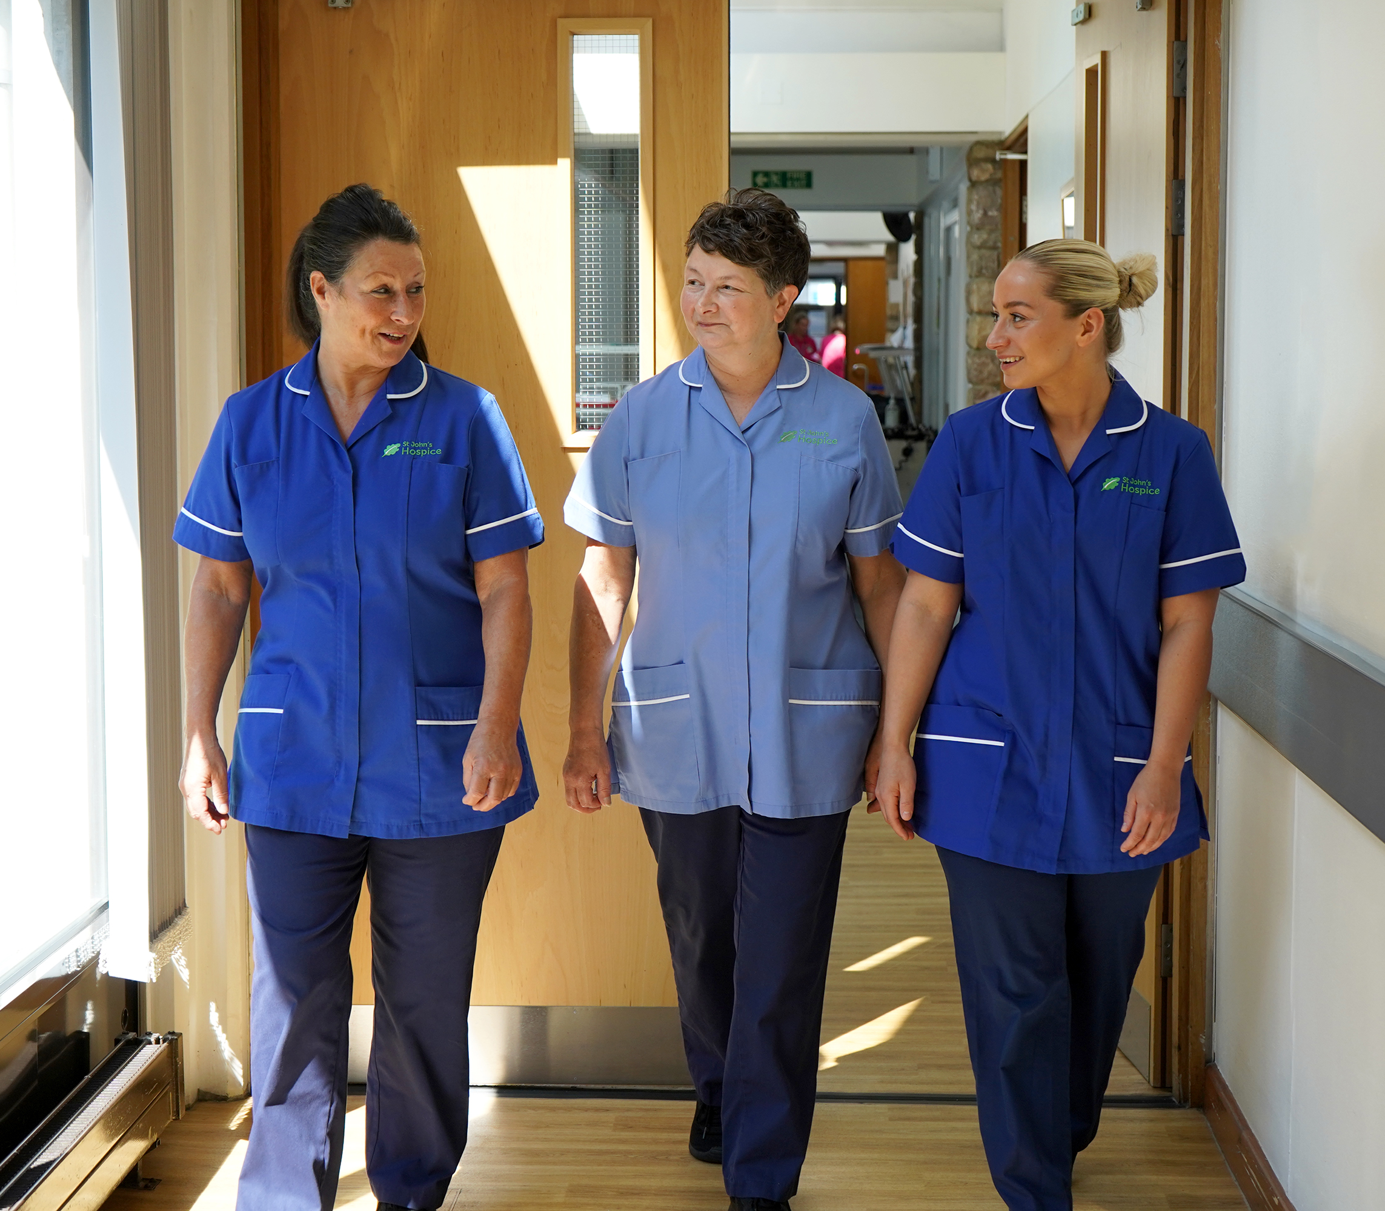
.

Slide 3
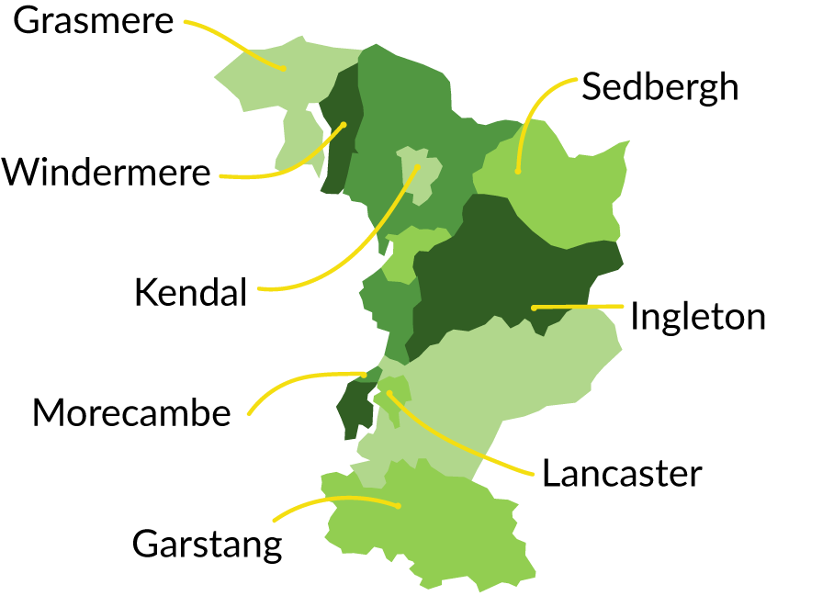
Where is
St John’s Hospice?

Slide 4
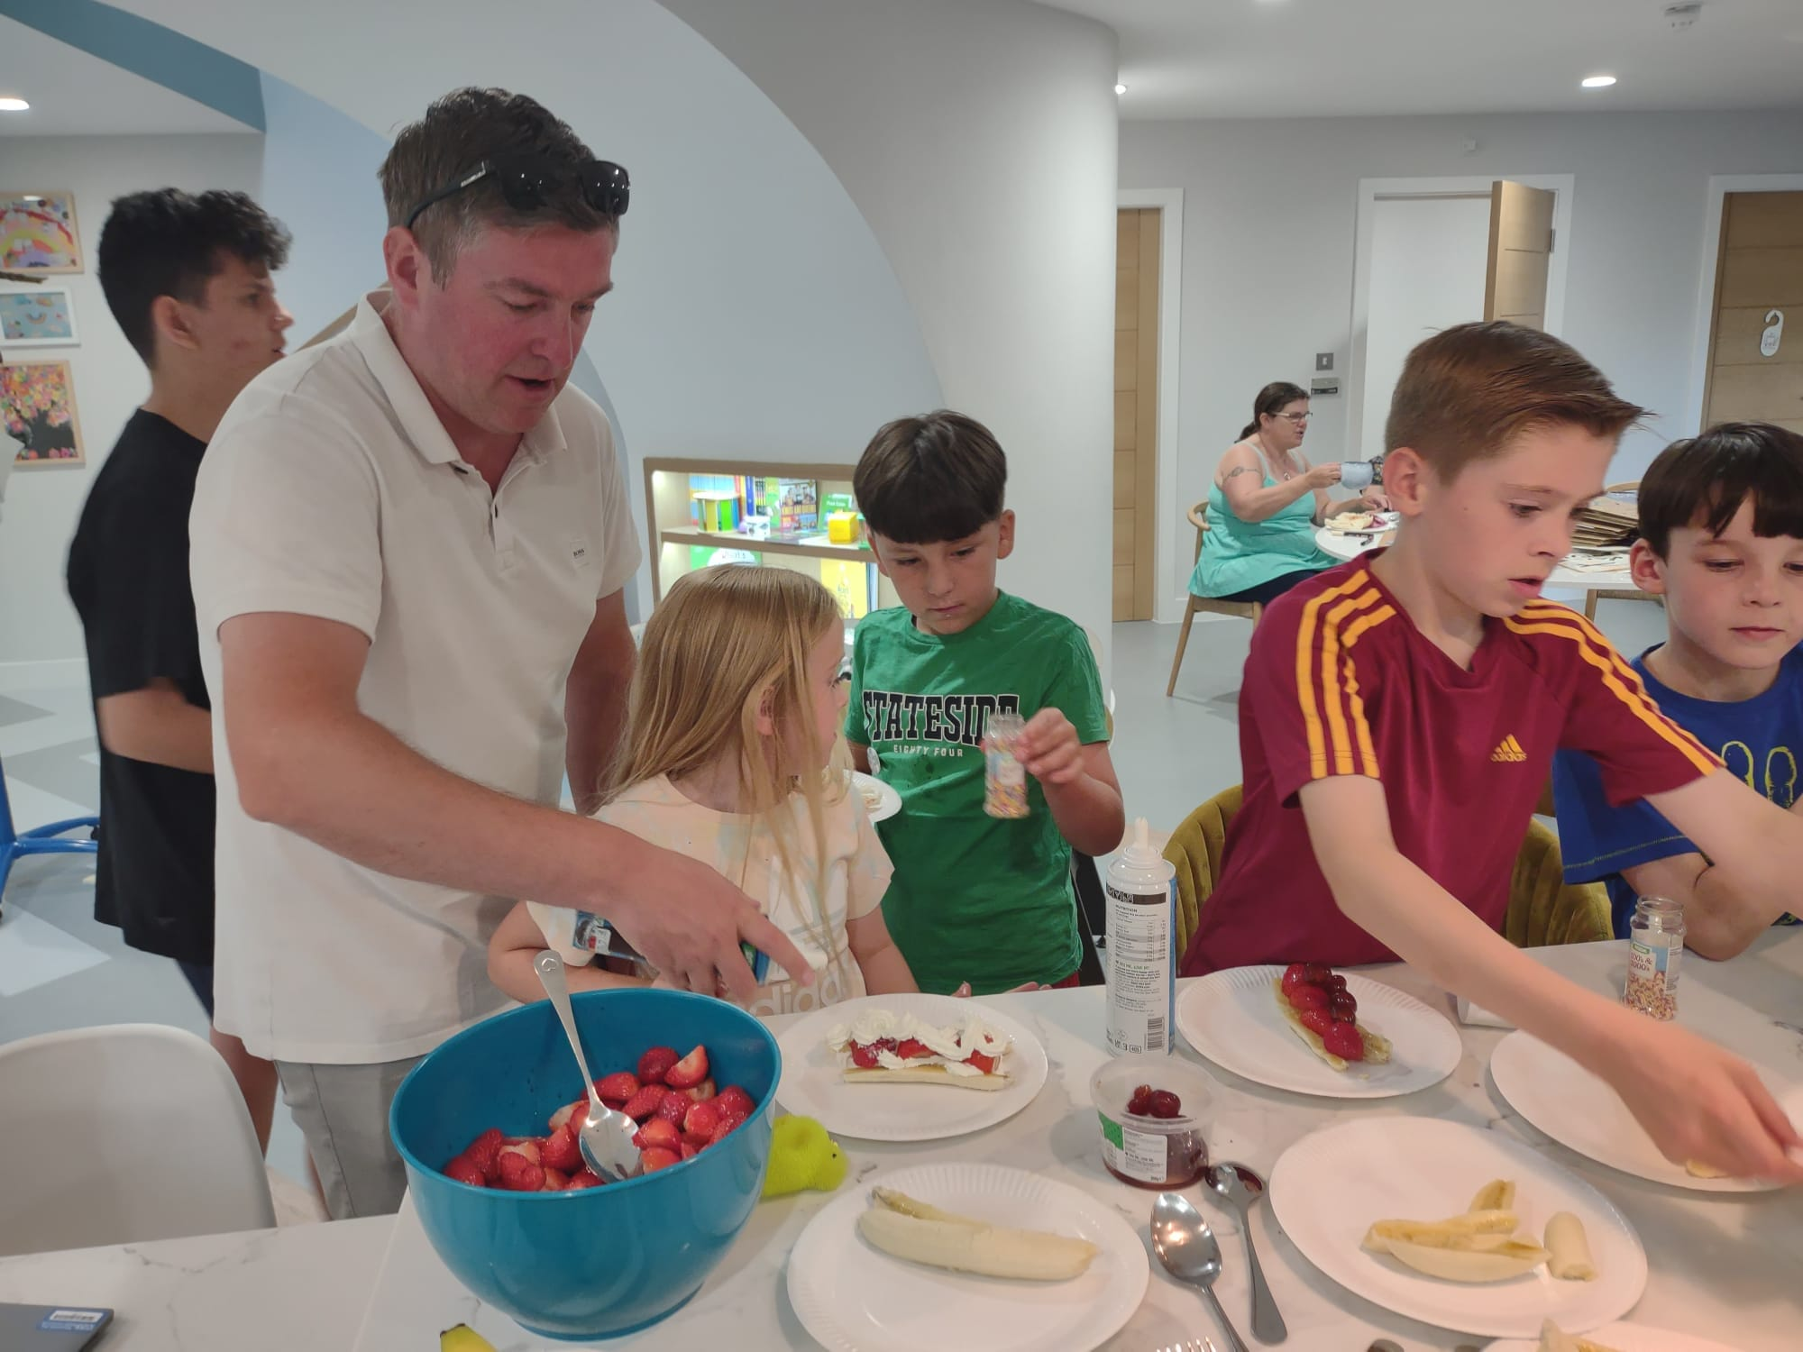
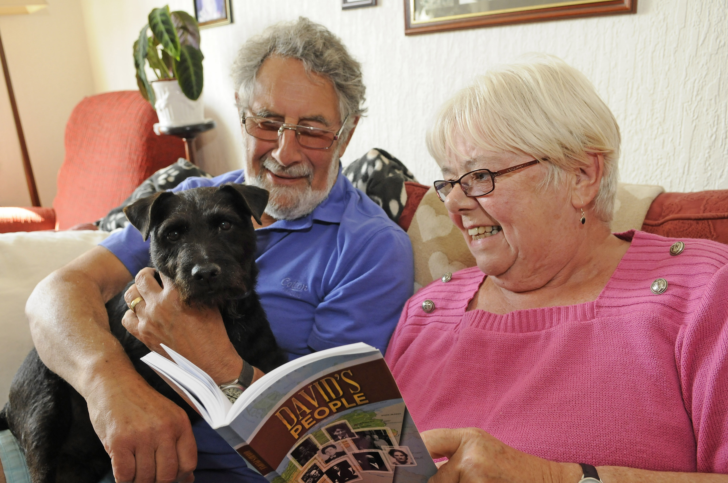
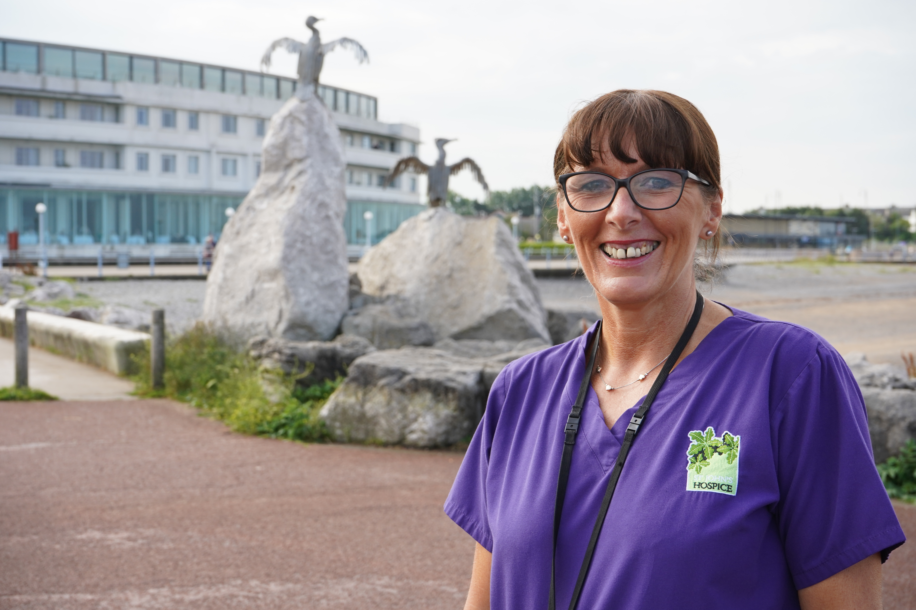
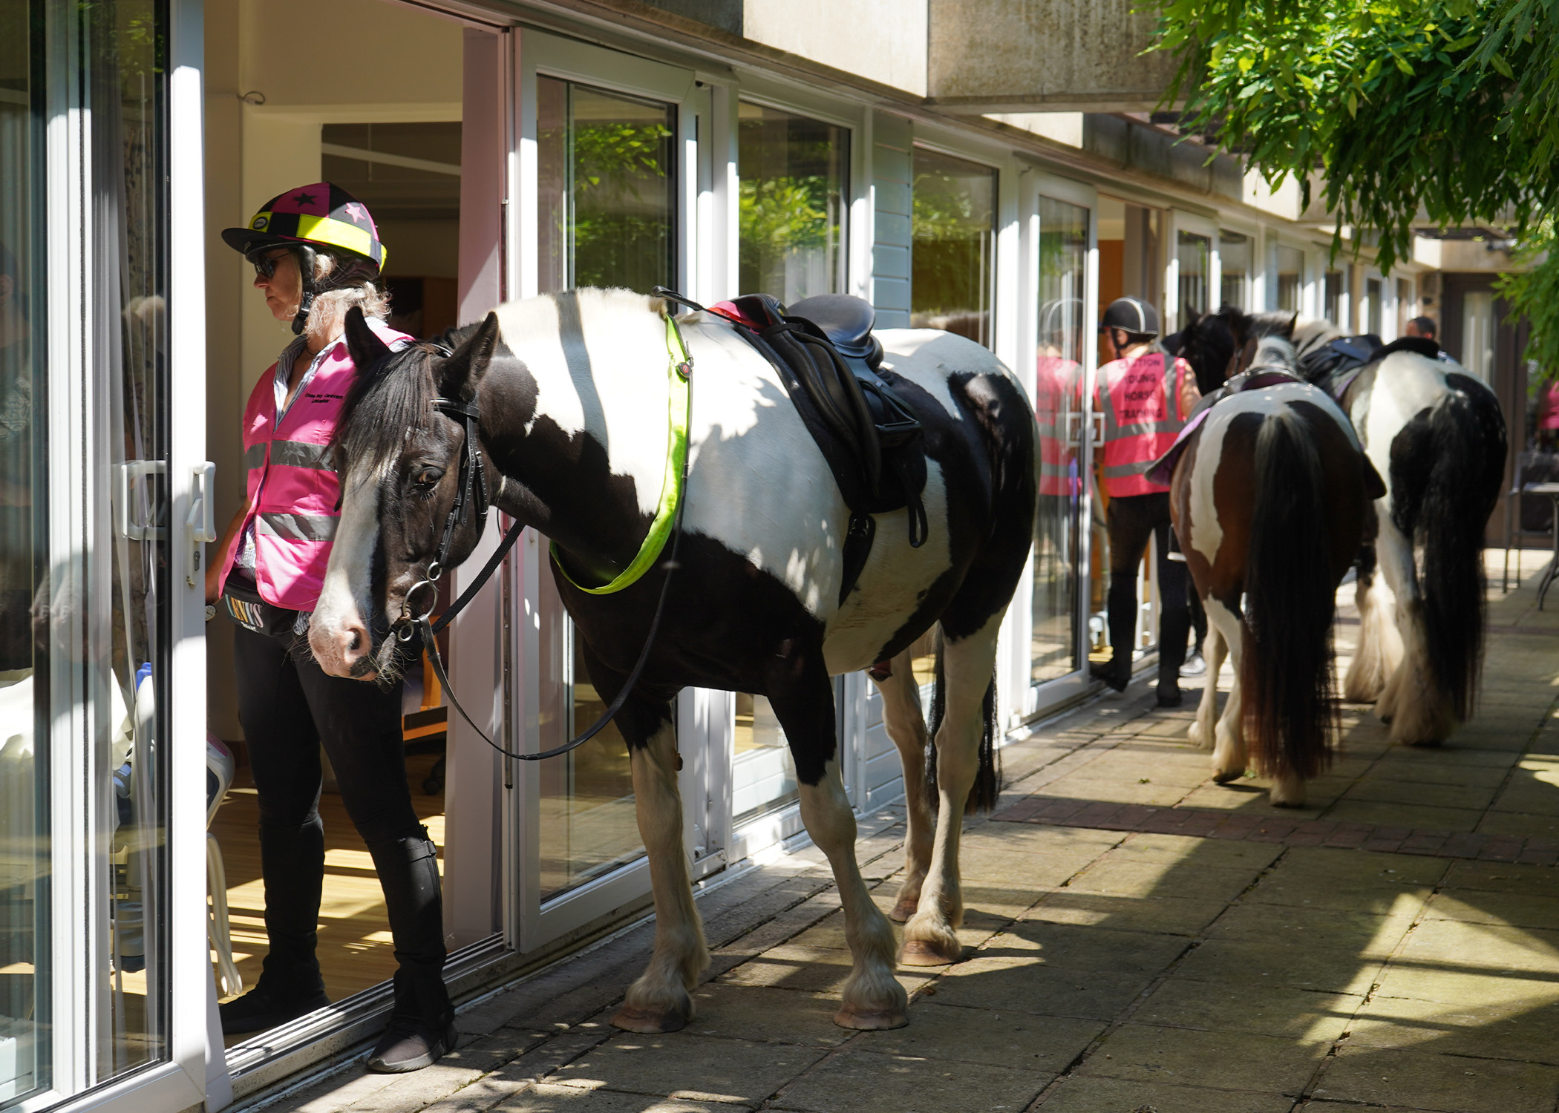
What is
St John’s Hospice?

Slide 5
How much does it cost to support our community?
£12,000 a day!

Slide 6
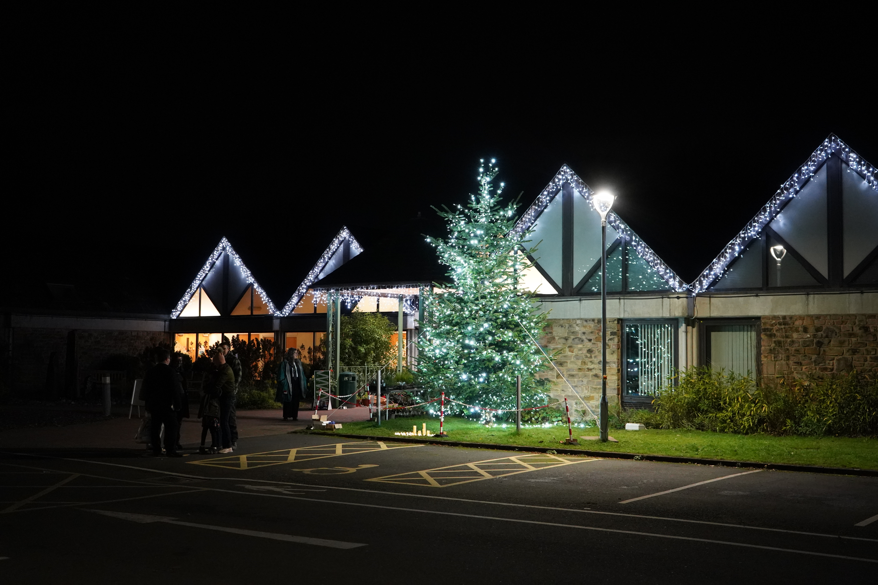
How can you help us this Christmas?
Be one of our…

Slide 7
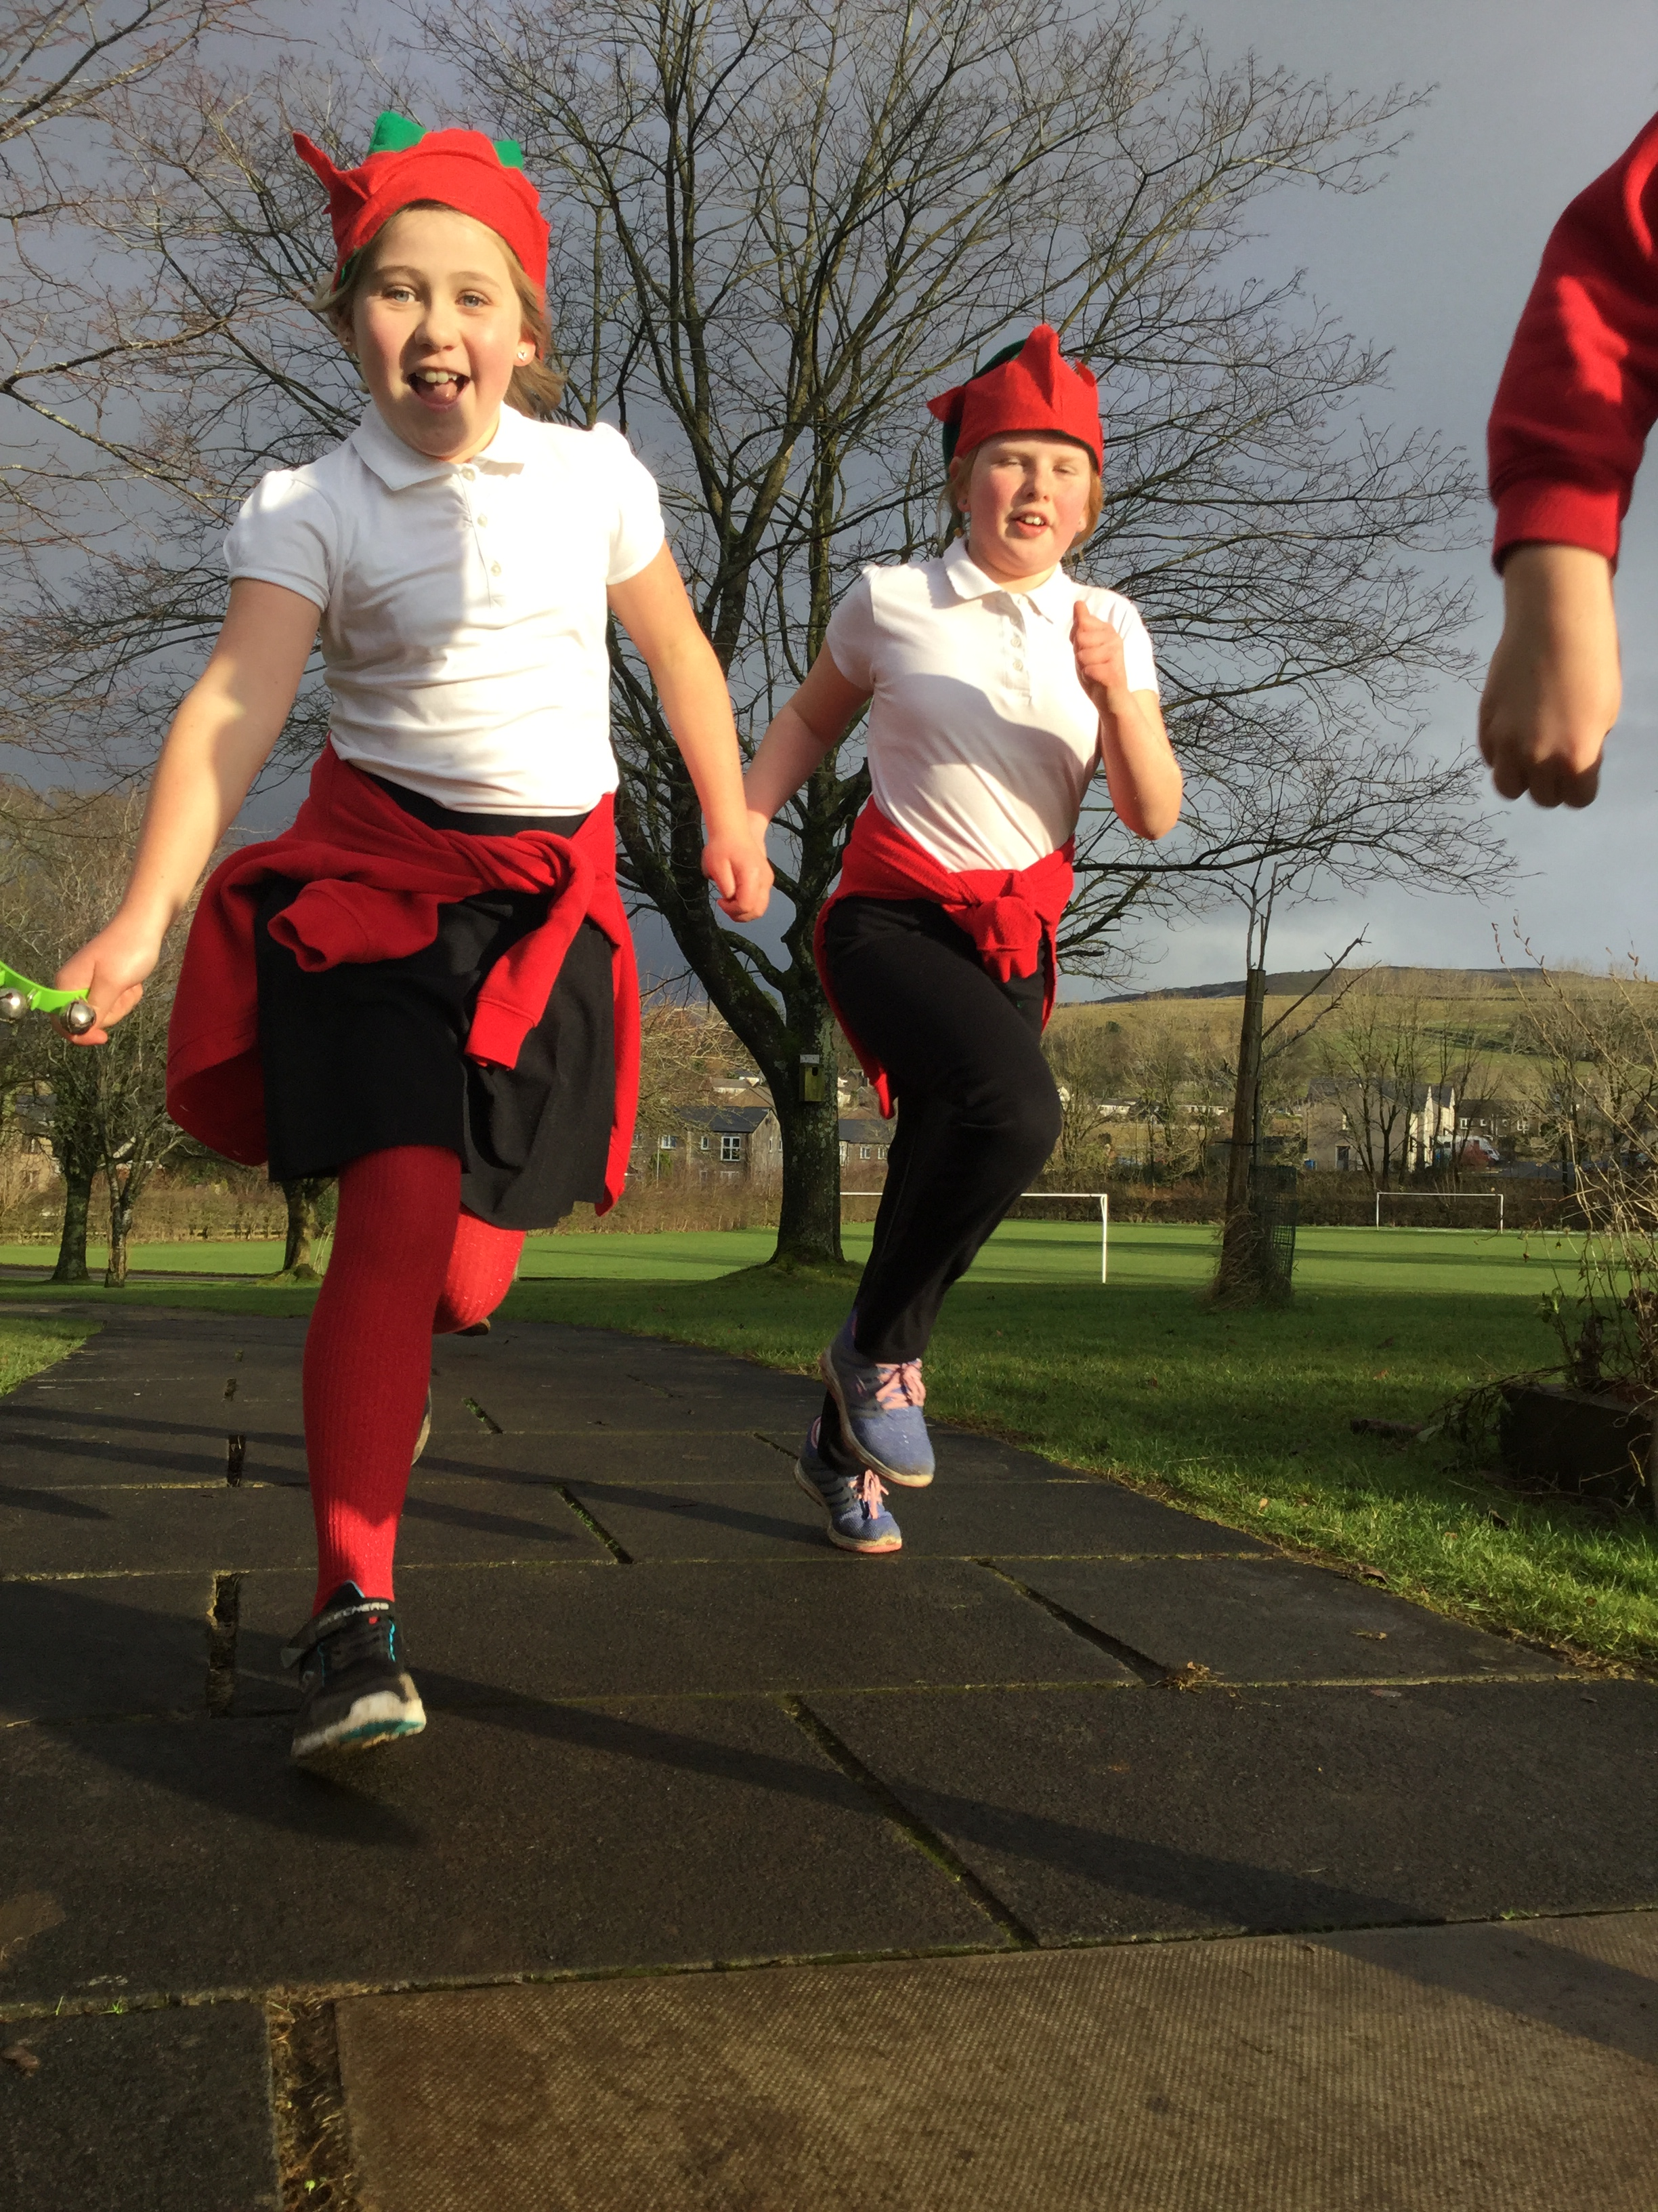

Slide 8
Your hats are in school now!
You can keep them
afterwards!

Slide 9
The easiest way to fundraise is through JustGiving!
Go to: www.justgiving.com/campaign/sjhelfrun
And click here to get started!

Slide 10
✓
Sponsor form
Mrs Jane Smith
1 High St, Lancaster
✓

Slide 11
Thank you for listening!

